Slide 1
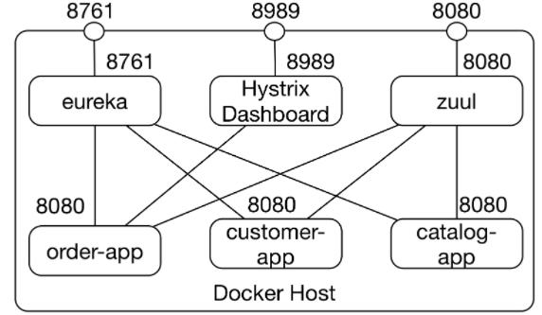
Microservice : Netflix Stack, Introduction
Netflix Stack, Why?
Netflix released its technologies as open-source projects making the Netflix stack one of the first stacks to implement microservices.
Details about service discovery with Eureka, routing with Zuul, load balancing with Ribbon, and resilience with Hystrix

Slide 2
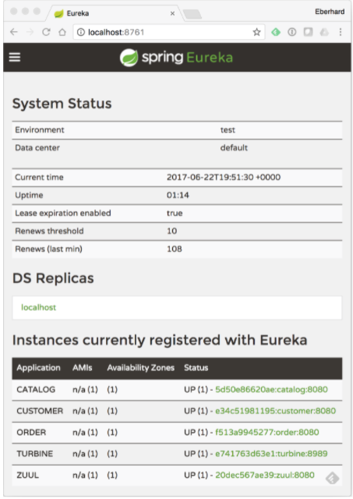
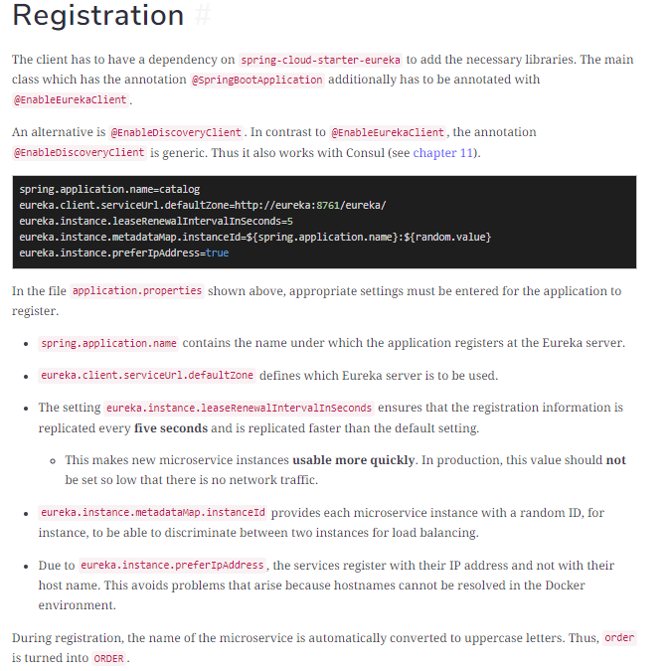
Microservice : Eureka, Service Discovery
Service Discovery
Eureka project open source downloaded from https://github.com/Netflix/eureka/ and you can build server and client from the code.
In the right side, we have picture of Eureka dashboard.
Each microservice is a Eureka client and must register with the Eureka server in order to inform the Eureka server about the name of the microservice, the IP-address, and port at which it can be reached.

Slide 3
Microservice : Zuul, Routing Solution
Routing Solution ( Zuul, from Netflix )
Zuul is the routing solution that is part of the Netflix stack.
Zuul is responsible for forwarding external calls to the correct microservice.

